Slide 1

Developing Live Win Probability Models for Soccer Matches
Summary Deck
November 2020
HDAG Group 2021 ® All Rights Reserved.

Slide 2
Developing Machine Learning Algorithms for Low Latency Win Probability Prediction
Problem
Client’s existing Win Probability Models relied heavily on slow
Monte Carlo simulations
Use Case
Faster predictions are necessary to update betting odds and detect fraud in real time
Solution
Machine Learning approaches can provide faster predictions with a small tradeoff in accuracy
Project Workflow
1
Process Coarse Grained Data
ML Models
Engineer Useful Features
Speed
2
3
Simulation
Develop Machine Learning Models
4
Accuracy
Evaluate Performance in Real Time

Slide 3


Data And Processing: Train off of Millions of Game events from Major European Leagues
Client Database
Aggregate Data from thousands of games across the major European Sports Leagues
Develop Data Processing Pipeline to generate Useful Features. For example the number of Red Cards for each team
Train Machine Learning Algorithms and Evaluate Performance

Slide 4
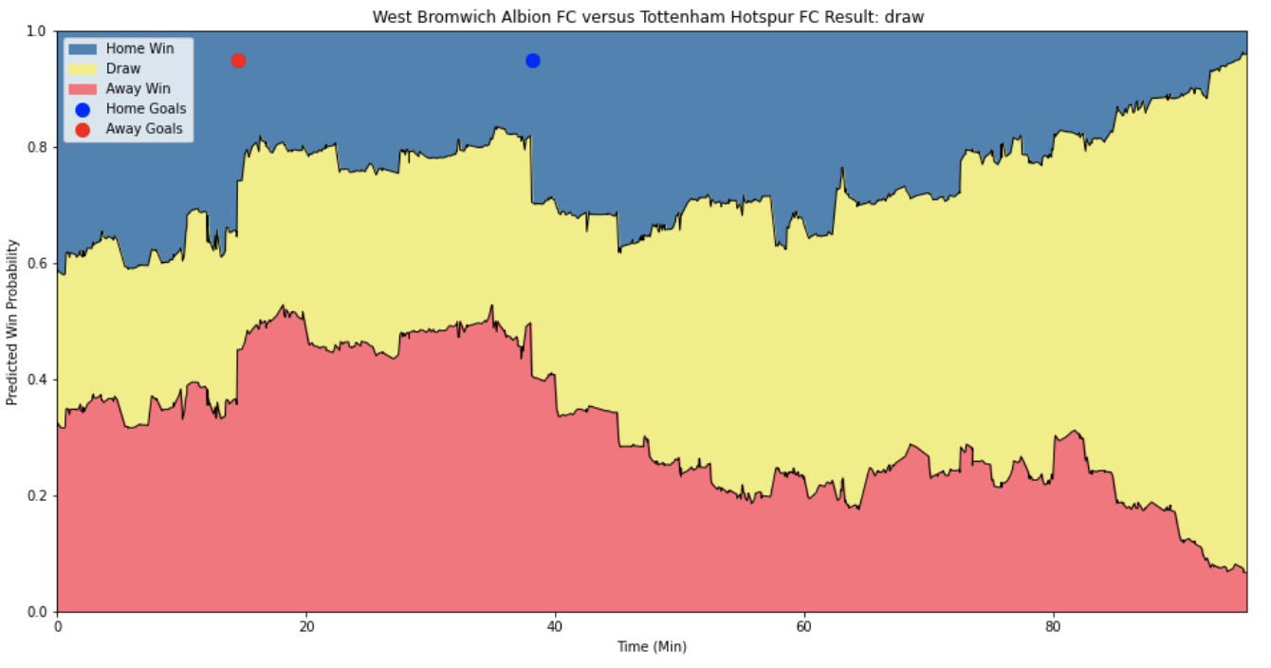
Modeling: Combine Results of Two Models to predict Win Probability
Model 1
Use historical results to estimate prematch strength of teams
Final Model: ELO with nonparametric Win Probability Estimates
Model 2
Update prematch probabilities in response to Game Events
Final Model: XGboost classifier

Slide 5
Developing Live Win Probability Models for Soccer
Problem
Client’s existing Win Probability Models relied heavily on slow
Monte Carlo simulations
Use Case
Faster predictions are necessary to update betting odds and detect fraud in real time
Solution
Machine Learning approaches can provide faster predictions with a small tradeoff in accuracy
Database of thousands of soccer games
Custom Feature Engineering
Train Machine Learning Models
Results:
ELO model for Team Ranking
GBoost Classifier for live predictions

